Slide 1
Global mart week 1-7 journey

Slide 2
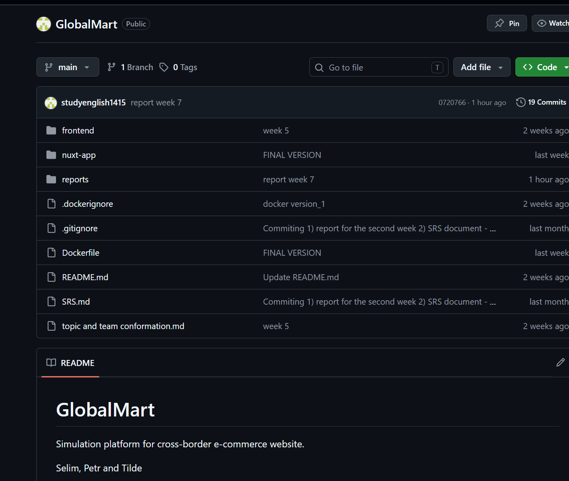
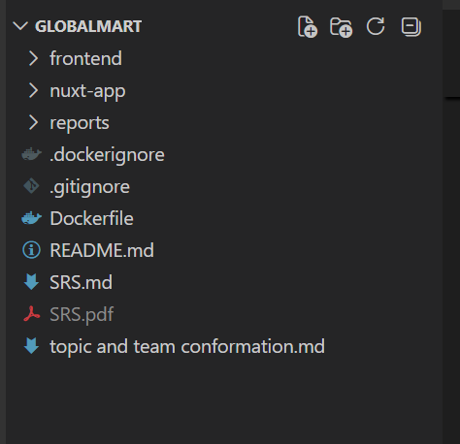
Week 1

Slide 3
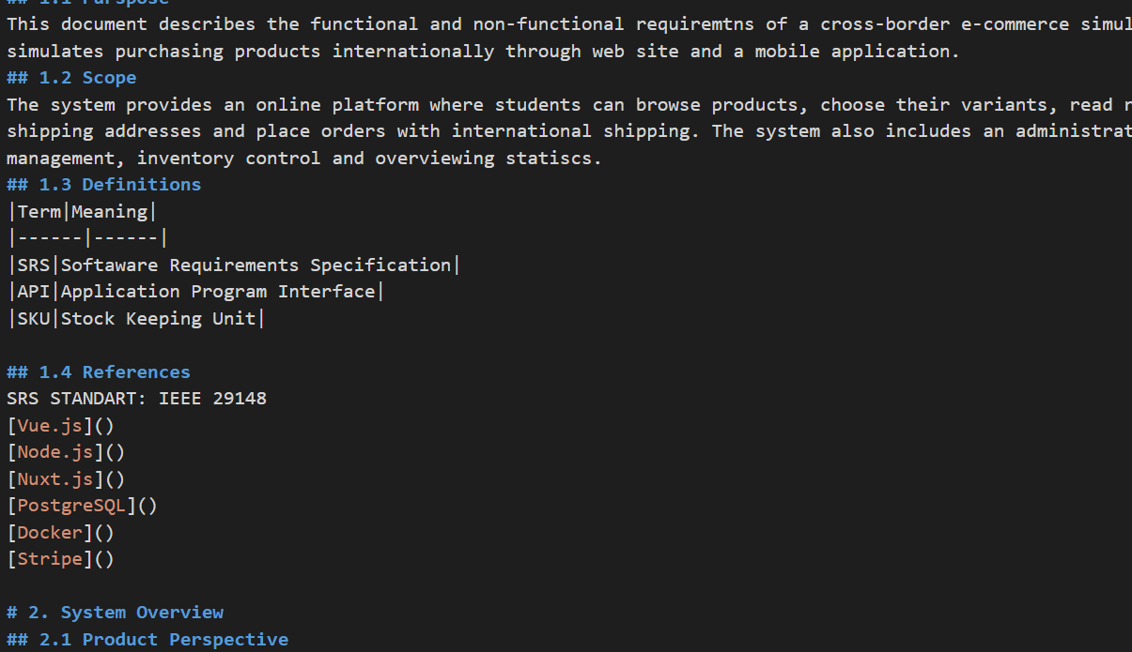
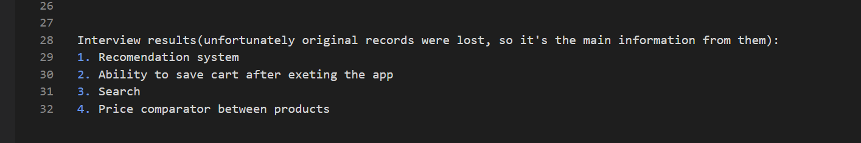
Week 2
REQUIREMENTS (Petr and Selim)
SRS DOCUMENT (Petr)
Priority Matrix (Selim)

Slide 4
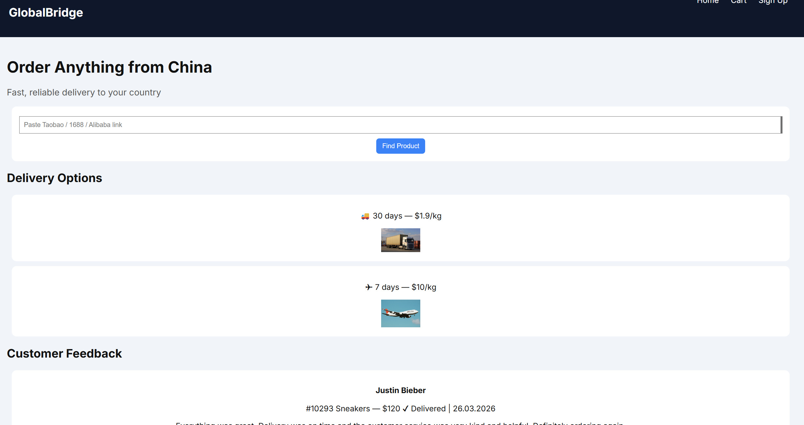
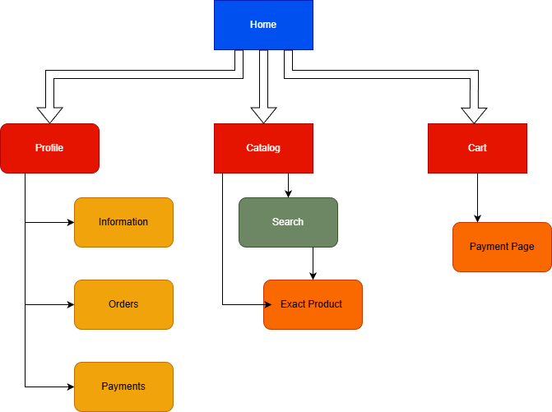
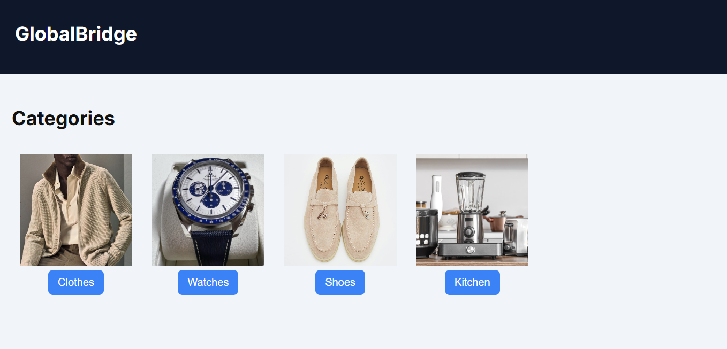
Week 3
First draft of UI (Selim)
Website map (Petr)

Slide 5
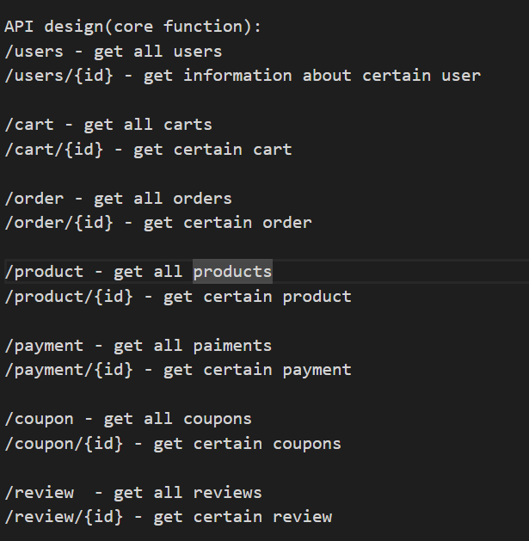
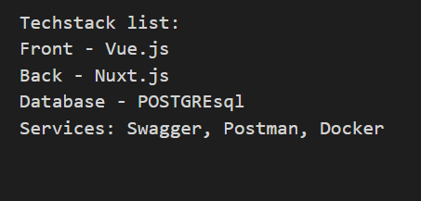
Week 4
RESTful API (Petr)
Tecklist (Selim)

Slide 6
NEW MEMEBER
Tilde Andreasson

Slide 7
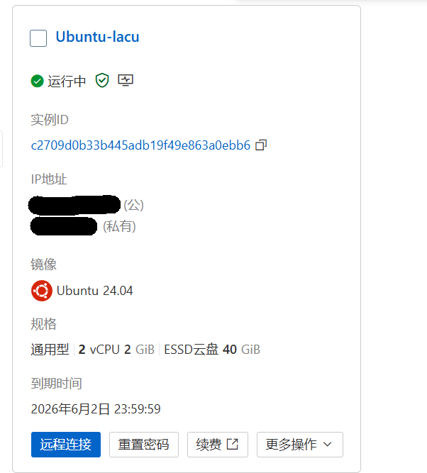
Week 5
New UI (Tilde)
Real Back developing (Petr)
Real database (Selim)

Slide 8
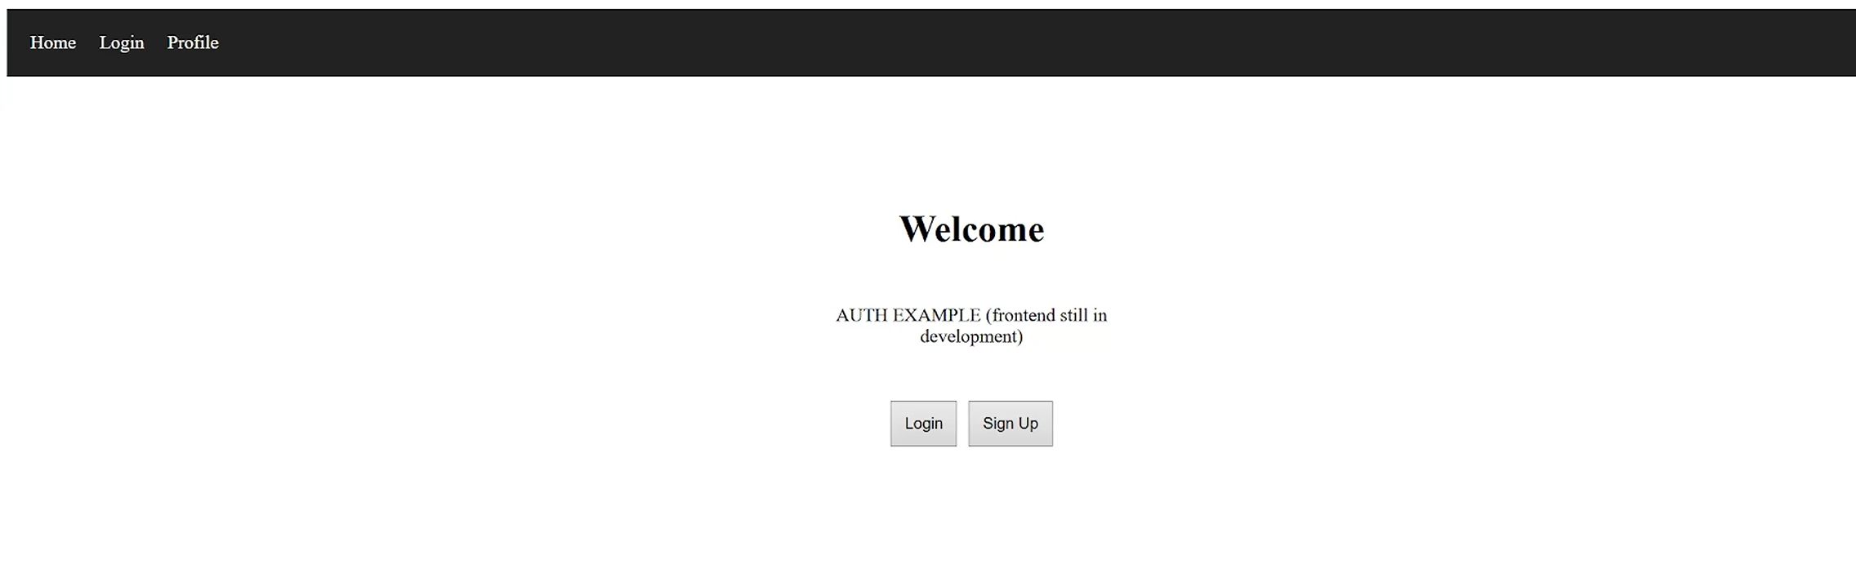
Week 6
AUTH module (Petr)
Frontend update (Tilde)

Slide 9
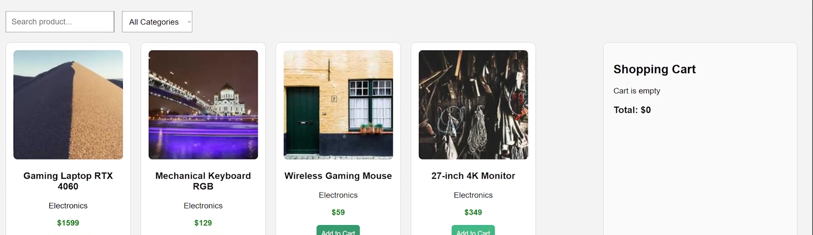
Week 7
Completed tasks:
1) Gathered example information for products including possible options, pictures, etc. (Selim)
2) Implemented UI especially search filtering and cart (Tilde)
3) First connect of db and frontend (Petr)

Slide 10
Thank you

